Slide 1

Department Of Computer Technology
MIT Campus, Anna University
Chennai, India.
31/5/2023

Slide 2
Effective Anomaly Detection in Autonomous Vehicles with Alert Tracking System
Presented by,
R. Sreenithi (Reg.no:2021614028) M.E. CSE Final Year Department of Computer Technology
Anna University, MIT Campus

Slide 3
Overview
Introduction
Literature survey
Existing challenges
Problem statement
Objectives
References

Slide 4
Introduction
Autonomous vehicles, known as self-driving cars or driverless cars, uses Artificial Intelligence (AI), sensors, and communication systems for autonomous operation.
This optimize traffic flow, reduce fuel consumption and lessen risk of accidents.
Autonomous vehicles can be categorized into five levels of automation:
Level 0: No automation
Level 1: Driver assistance – Adaptive Cruise Control (ACC), emergency braking and acceleration.
Level 2: Partial automation - The vehicle can control steering, acceleration, and braking, but the driver must remain alert and ready to take over if necessary.
Example: Tesla auto pilot
Level 3: Conditional automation – operates independently in some driving situations, but the driver must be ready to take over when alerted by the vehicle.
Example: Audi traffic jam pilot

Slide 5
Level 4: High automation - Operate independently in most driving situations, but require a human driver in certain circumstances.
Example: Waymo firefly
Level 5: Full automation - Operate independently in all driving situations without human intervention.
Example: BMW I Next, Audi Alcon
Components of autonomous vehicles:
Sensors: cameras, radar, lidar, and ultrasonic sensors provide the vehicle a detailed view of its surroundings.
Control systems: to make decisions about how to navigate their environment.
Communication systems: to exchange information with other vehicles such as traffic lights and road signs.
Mapping technology: Allows the road network, including lane markings, road signs, and speed limits.
Actuators: variety of actuators, including motors and brakes, which allow the vehicle to accelerate, decelerate, and steer.
Computing systems: powerful processors and graphics cards, to process the data from the sensors and make decisions.

Slide 6
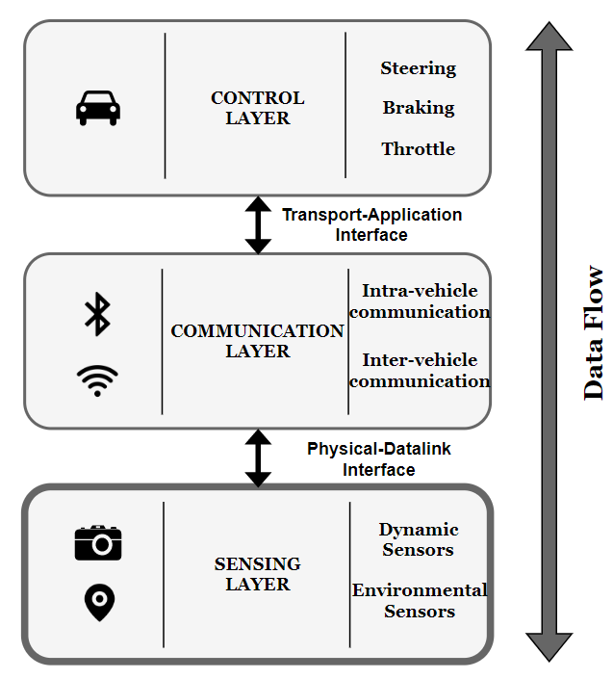
Autonomous Vehicle Architecture

Slide 7
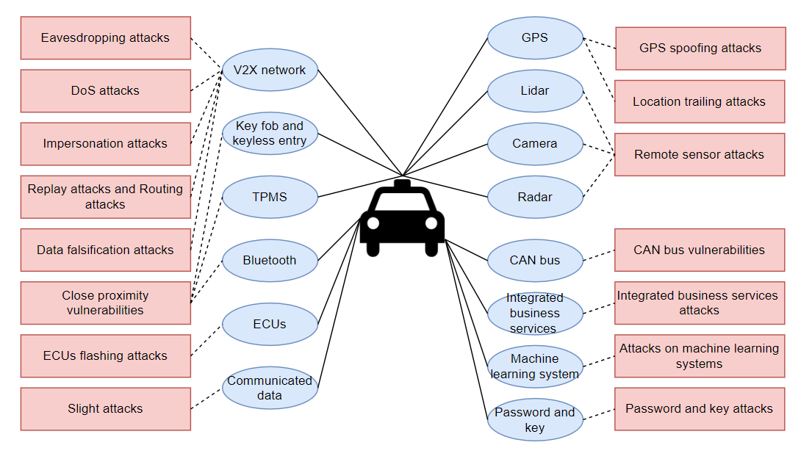
Attacks On AV Components

Slide 8
Literature Survey
SNO | TITLE OF THE PAPER | NAME OF THE JOURNAL AND PUBLISHED YEAR | PROPOSED WORK | PROPOSED METHODOLOGY /ALGORITHM | LIMITATIONS
1 | A Sensor Fusion-Based GNSS Spoofing Attack Detection Framework for Autonomous Vehicles | IEEE Transactions On Intelligent Transportation Systems, VOL. 23, NO. 12, DEC 2022 | A sensor fusion-based Global Navigation Satellite System (GNSS) spoofing attack detection framework for autonomous vehicles (AVs) of two strategies: (i) comparison between predicted location shifts and motion stated and (ii) detection and classification of turns | In-vehicle inertial sensors—i.e., speedometer, accelerometer fed to a long short-term memory (LSTM) ,next combines k-Nearest Neighbors (k-NN) and Dynamic Time Warping (DTW) algorithms to detect a turn and then classify left and right turns using steering angle sensor output | - Robust anti-spoofing technologies to mitigate spoofing attacks on GNSS receivers
2 | A Fault Detection and Diagnosis System for Autonomous Vehicles Based on Hybrid Approaches | IEEE Sensors Journal, VOL. 20, NO. 16, AUG 15, 2020 | An accurate fault detection and diagnosis system to prevent the potential hazardous situations | Support Vector Machine (SVM) method is adopted to train the boundary curve which separates the safe domain and unsafe domain, a Kalman filter observer is designed to predict the current position of the vehicle | - Type of the subsystem causes the fault

Slide 9
Literature Survey
SNO | TITLE OF THE PAPER | NAME OF THE JOURNAL AND PUBLISHED YEAR | PROPOSED WORK | PROPOSED METHODOLOGY /ALGORITHM | LIMITATIONS
3 | A Fast Anomaly Diagnosis Approach Based on Modified CNN and Multisensor Data Fusion | IEEE Transactions On Industrial Electronics, VOL. 69, NO. 12, DEC 2022 | A modified convolutional neural network (CNN) algorithm, namely 1D-GAPCNN-SVM, is proposed to address the early anomaly diagnosis problem. | To reduce the number of parameters, a 1-D global average pooling layer is designed, a nonlinear multiclass support vector machine (SVM) is adopted to replace the traditional Softmax classifier as the final discriminator | - 2D-model with inefficient multisensor data fusion
4 | CANnolo: An Anomaly Detection System Based on LSTM Autoencoders for Controller Area Network | IEEE Transactions On Network And Service Management, VOL. 18, NO. 2, JUN 2021 | CANnolo, an IDS based on Long Short-Term Memory (LSTM)- autoencoders to identify anomalies in Controller Area Networks (CANs) | CANnolo automatically analyzes the CAN streams and builds a data sequences and detects anomalies by computing difference between the reconstructed and the respective real sequences. | - Different data over time series makes it relatively slow computation

Slide 10
Literature Survey
SNO | TITLE OF THE PAPER | NAME OF THE JOURNAL AND PUBLISHED YEAR | PROPOSED WORK | PROPOSED METHODOLOGY /ALGORITHM | LIMITATIONS
5 | A Unified Bayesian Framework for Joint Estimation and Anomaly Detection in Environmental Sensor Networks | IEEE ACCESS ,DEC 2022 | A novel unified Bayesian framework that enable simultaneous estimation and identification of multiple and possibly different types of anomalies that can affect sensors in environmental sensor networks | The optimal joint maximum-likelihood and maximum a-posteriori (ML-MAP) estimation method to achieve almost the same performance of the joint ML-MAP | Computational complexity in cost analysis, to increase the percent of faulty nodes in network
6 | A Fault Detection and Diagnosis System for Autonomous Vehicles Based on Hybrid Approaches | IEEE Sensors Journal, VOL. 20, NO. 16, AUG 15, 2020 | An accurate fault detection and diagnosis system to prevent the potential hazardous situations | Support Vector Machine (SVM) method is adopted to train the boundary curve which separates the safe domain and unsafe domain, a Kalman filter observer to predict the current position of the vehicle | - Type of the subsystem causes the fault

Slide 11
Literature Survey
SNO | TITLE OF THE PAPER | NAME OF THE JOURNAL AND PUBLISHED YEAR | PROPOSED WORK | PROPOSED METHODOLOGY /ALGORITHM | LIMITATIONS
7 | Filter-Based Secure Dynamic Pose Estimation for Autonomous Vehicles | IEEE Sensors Journal, VOL. 19, NO. 15, AUG 1, 2019 | Recursive secure dynamic estimator has been designed to tackle the state estimation problem for autonomous vehicles in the circumstance of possible sensor attacks | Proposed estimator coincides with the conventional Kalman filter when all sensors on autonomous vehicles are benign | - Pose estimation when sensors fail
8 | Learning-Based Attacks in Cyber-Physical Systems | IEEE Transactions On Control Of Network Systems, VOL. 8, NO. 1, MAR 2021 | An arbitrary learning algorithm to estimate the system dynamic | The controller improves the security imposing crafted privacy-enhancing signal on top of the “nominal control policy.” | - Controller does not know the exact time instant at which an attack might occur as in non-linear system

Slide 12
Literature Survey
SNO | TITLE OF THE PAPER | NAME OF THE JOURNAL AND PUBLISHED YEAR | PROPOSED WORK | PROPOSED METHODOLOGY /ALGORITHM | LIMITATIONS
9 | “Seeing is Not Always Believing”: Detecting Perception Error Attacks Against Autonomous Vehicles | IEEE Transactions On Dependable And Secure Computing, VOL. 18, NO. 5, OCT 2021 | The impact of perception error attacks (PEAs) on autonomous vehicles, and propose a countermeasure called LIFE | The impact of perception error attacks (PEAs) and propose a countermeasure called LIFE (LIDAR and Image data Fusion for detecting perception Errors) | -Lack of data, with good weather and excellent field of view to driver
10 | Toward Interpretability in Fault Diagnosis for Autonomous Vehicles: Interpretation of Sensor Data Anomalies | IEEE Sensors Journal, VOL. 23, NO. 5, 1 MARCH 2023 | Environmental impact is first evaluated using the noise energy as a measure to interpret the impact on sensor data caused by the environment | Savitzky–Golay filters are applied for online denoising, to mitigate the impact and to enhance the data quality. Adversarial learned denoising shrinkage autoencoder (ALDSAE), an adversarial learning neural network, is constructed for sensor data anomaly detection | -Fault interpretation in Avs are complex to compute

Slide 13
Existing Challenges
It is a challenge to distinguish between intentional and unintentional interference in spoofing attacks.
Pose estimation is a critical problem in autonomous vehicle navigation, especially in circumstances where sensor failure or attacks exist.
An accurate fault detection and diagnosis system is of great importance for autonomous vehicles to prevent the potential hazardous situations.
Modern vehicles are vulnerable to multiple types of attacks leveraging remote, direct and indirect physical access, which allow attackers to gain control and affect safety-critical systems.

Slide 14
Problem Statement
Autonomous vehicles rely on various sensors, software, and hardware sensor components to navigate and make decisions.
Spoofing attack in vehicles can manipulate the velocity and acceleration data derived from magnetic encoders and inertial sensors which provides falsified data to other vehicles.
The natural correlation between velocity, acceleration and the lane speed limit in autonomous vehicles helps to identify and analyze anomalies present in dynamic sensors.
The proposing Autonomous Lane Speed Detection system helps to identify the anomalous vehicles from the group of vehicles with their magnetic encoders and inertial sensor data.
This manipulation can mislead the AVs into making incorrect decisions based on the spoofed sensor information.

Slide 15
Objectives
To identify the spoofing attack in dynamic sensor of autonomous vehicles and the correlation between the velocity and acceleration impact the overall performance of the autonomous system.
To identify the relation of the lane speed limits with vehicle’s speed measured using dynamic sensors is evaluated to find the anomaly in vehicles using Autonomous Lane Speed Detection System (ALSD).

Slide 16
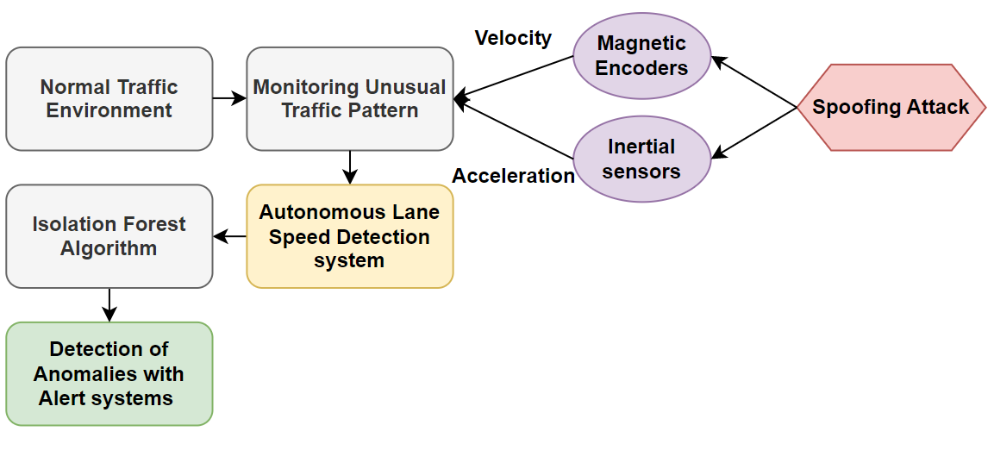
Proposed System Flow

Slide 17
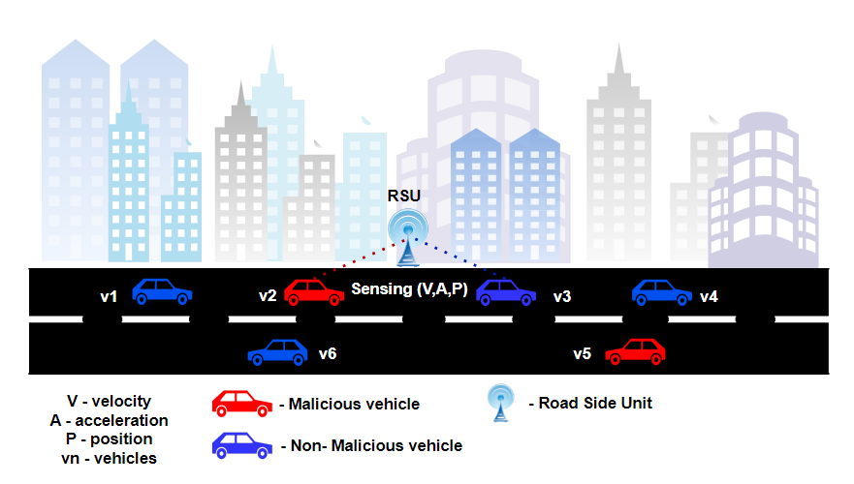
System Architecture

Slide 18
Algorithm 1 - Autonomous Lane Speed Detection System
Input:
current_speed: Current speed of the vehicle
target_speed: Desired speed
lane_speed_limit: Speed limit of the lane
Output: final_acceleration: Final acceleration to control the vehicle's speed
1: function control_vehicle_speed(current_speed, target_speed, lane_speed_limit)
2: acceleration_limit ← 2.0 // Maximum allowed acceleration
3: deceleration_limit ← -4.0 // Maximum allowed deceleration
4: speed_difference ← target_speed - current_speed
5: if speed_difference > 0 then
6: acceleration ← min(speed_difference, acceleration_limit)
7: else
8: deceleration ← max(speed_difference, deceleration_limit)

Slide 19
Algorithm 1 - Autonomous Lane Speed Detection System
12: // Check if the calculated acceleration or deceleration exceeds the limits
13: if current_speed + acceleration > lane_speed_limit then
14: // Adjust acceleration to reach the lane speed limit
15: acceleration ← lane_speed_limit - current_speed
16: else if current_speed + deceleration < lane_speed_limit then
17: // Adjust deceleration to reach the lane speed limit
18: deceleration ← current_speed - lane_speed_limit
19: // Determine the final acceleration based on the calculated values
20: final_acceleration ← acceleration if acceleration is not None else deceleration
21: return final_acceleration

Slide 20
Mathematical Analysis

Slide 21
Objectives
To understand how different vehicle parameters interact with each other and impact the overall performance of the autonomous system.
To identify the correlation of the lane speed limits with vehicle speed with velocity and acceleration measured using dynamic sensors is evaluated to find the spoofing attack in vehicles using Autonomous Lane Speed Detection System (ALSD).

Slide 22
References
W. Gong, Y. Wang, M. Zhang, E. Mihankhah, H. Chen and D. Wang, "A Fast Anomaly Diagnosis Approach Based on Modified CNN and Multisensor Data Fusion," in IEEE Transactions on Industrial Electronics, vol. 69, no. 12, pp. 13636-13646, Dec. 2022.
Y. Fang, H. Min, W. Wang, Z. Xu and X. Zhao, "A Fault Detection and Diagnosis System for Autonomous Vehicles Based on Hybrid Approaches," in IEEE Sensors Journal, vol. 20, no. 16, pp. 9359-9371, 15 Aug.15, 2020.
S. Dasgupta, M. Rahman, M. Islam and M. Chowdhury, "A Sensor Fusion-Based GNSS Spoofing Attack Detection Framework for Autonomous Vehicles," in IEEE Transactions on Intelligent Transportation Systems, vol. 23, no. 12, pp. 23559-23572, Dec. 2022, doi: 10.1109/TITS.2022.3197817.
A. Fascista, A. Coluccia and C. Ravazzi, "A Unified Bayesian Framework for Joint Estimation and Anomaly Detection in Environmental Sensor Networks," in IEEE Access, vol. 11, pp. 227-248, 2023.
S. Longari, D. H. Nova Valcarcel, M. Zago, M. Carminati and S. Zanero, "CANnolo: An Anomaly Detection System Based on LSTM Autoencoders for Controller Area Network," in IEEE Transactions on Network and Service Management, vol. 18, no. 2, pp. 1913-1924, June 2021.

Slide 23
References (Cont.)
F. Guo et al., "Detecting Vehicle Anomaly in the Edge via Sensor Consistency and Frequency Characteristic," in IEEE Transactions on Vehicular Technology, vol. 68, no. 6, pp. 5618-5628, June 2019.
X. Liu, R. Jiang, H. Wang and S. S. Ge, "Filter-Based Secure Dynamic Pose Estimation for Autonomous Vehicles," in IEEE Sensors Journal, vol. 19, no. 15, pp. 6298-6308, 1 Aug.1, 2019.
M. J. Khojasteh, A. Khina, M. Franceschetti and T. Javidi, "Learning-Based Attacks in Cyber-Physical Systems," in IEEE Transactions on Control of Network Systems, vol. 8, no. 1, pp. 437-449, March 2021.
J. Liu and J. -M. Park, "“Seeing is Not Always Believing”: Detecting Perception Error Attacks Against Autonomous Vehicles," in IEEE Transactions on Dependable and Secure Computing, vol. 18, no. 5, pp. 2209-2223, 1 Sept.-Oct. 2021.
J. Liu and J. -M. Park, "“Seeing is Not Always Believing”: Detecting Perception Error Attacks Against Autonomous Vehicles," in IEEE Transactions on Dependable and Secure Computing, vol. 18, no. 5, pp. 2209-2223, 1 Sept.-Oct. 2021.
Z. El-Rewini, K. Sadatsharan, N. Sugunaraj, D. F. Selvaraj, S. J. Plathottam and P. Ranganathan, "Cybersecurity Attacks in Vehicular Sensors," in IEEE Sensors Journal, vol. 20, no. 22, pp. 13752-13767, 15 Nov.15, 2020, doi: 10.1109/JSEN.2020.3004275.

Slide 24
Thank you

